Slide 1

WEB TECHNOLOGIES
COURSE CODE: CS3005
CREDITS: 3
UNIT-3
Dr.M.Amsaprabhaa
Assistant Professor
Department of CSE
Shiv Nadar University Chennai

Slide 2
SYLLABUS
UNIT 1 - WEB SITE BASICS
Web Essentials: Introduction to HTML, CSS, JavaScript - Data types, Arrays, Functions, Other built-in objects. DOM - Document tree traversal and manipulations, Event handling. Introduction to AJAX - Request, Response.
UNIT 2 - CLIENT-SIDE PROGRAMMING
Frontend Development: React JS/ React Overview, Model-View-Controller (MVC) Architecture, Introduction to ECMAScript6 (ES6), Virtual DOM, Javascript with XML (JSX), Components - Functional Component, Exporting and Importing Components, States, Props, Hooks – useState, useEffect, React Routing, React Bootstrap.
UNIT 3 - SERVER-SIDE SCRIPTING
Backend Development: Introduction Node.js ( long-term support: LTS) – Modules, HTTP Module, File System, Node Package Manager (NPM), URL, Structured Data: MySQL, and Unstructured Data: MongoDB – Connecting, Creating, and Manipulating Databases, Express.
UNIT 4 - WEB SERVICES, API AND FSD
Introduction- SOAP, REST, SOAP Architecture, REST: Architecture, Requests and Responses, RESTful APIs, OData, Micro services Full Stack Development (FSD): MERN Stack.
UNIT 5 - VERSION CONTROL AND DEPLOYMENT
Introduction to Version Control (GIT/GITHUB), APIs Security – Designing, Creating, Testing and Validating RESTful APIs, Introduction to Postman for API testing, Public Hosting, Project Deployment and Maintenance.

Slide 3
Node.js Introduction
Here is how PHP or ASP handles a file request:
Sends the task to the computer's file system.
Waits while the file system opens and reads the file.
Returns the content to the client.
Ready to handle the next request.
What is Node.js?
Node.js is an open source server environment
Node.js is free
Node.js runs on various platforms (Windows, Linux, Unix, Mac OS X, etc.)
Node.js uses JavaScript on the server
Here is how Node.js handles a file request:
Sends the task to the computer's file system.
Ready to handle the next request.
When the file system has opened and read the file, the server returns the content to the client.
Node.js eliminates the waiting, and simply continues with the next request.
Node.js runs single-threaded, non-blocking, asynchronous programming, which is very memory efficient.
Why Node.js?
Node.js uses asynchronous programming!
Node.js is used to build back-end services like APIs like Web App, Mobile App or Web Server.
A Web Server will open a file on the server and return the content to the client.
It’s used in production by large companies such as Paypal, Uber, Netflix, Walmart, and so on.

Slide 4
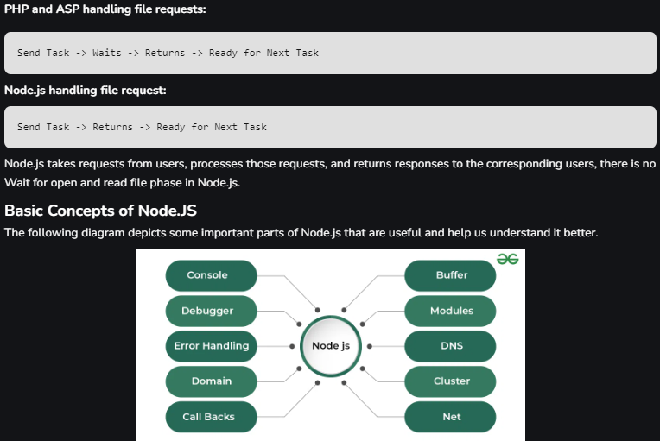
Node.js Introduction
Reasons to Choose Node.js
Easy to Get Started: Node.js is beginner-friendly and ideal for prototyping and agile development.
Scalability: It scales both horizontally and vertically.
Real-Time Web Apps: Node.js excels in real-time synchronization.
Fast Suite: It handles operations quickly (e.g., database access, network connections).
Unified Language: JavaScript everywhere—frontend and backend.
Rich Ecosystem: Node.js boasts a large open-source library and supports asynchronous, non-blocking programming.

Slide 5
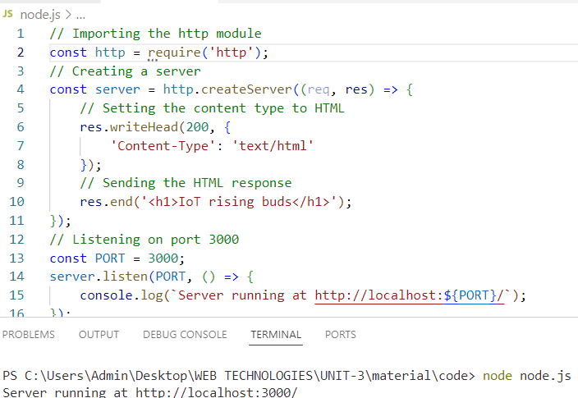
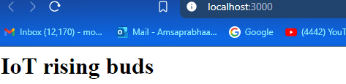
HTTP MODULE
Code Explaination:
We use the http module to create an HTTP server.
The server listens on the specified port and hostname.
When a new request arrives, the callback function handles it by setting the response status, headers, and content.

Slide 6
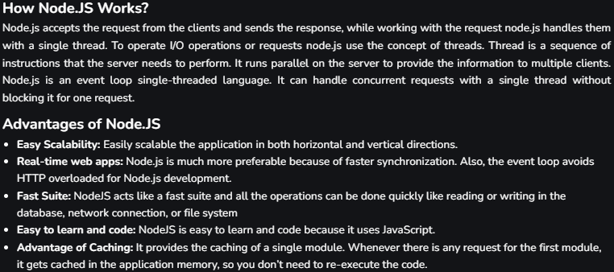
Node.js

Slide 7
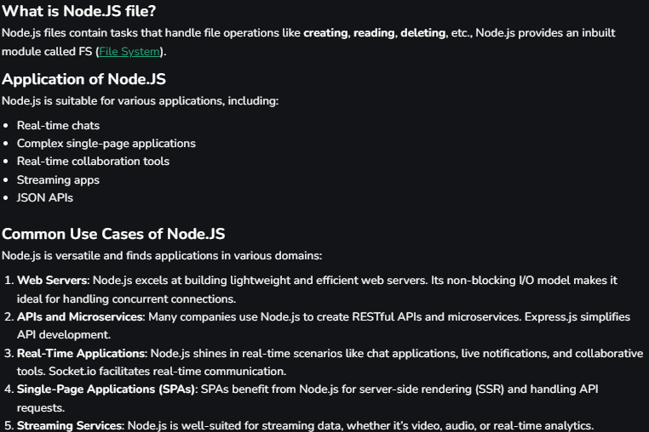
Node.JS file

Slide 8
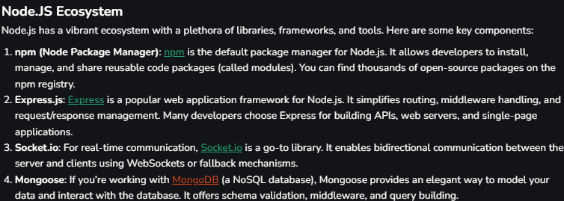
Node.JS key components

Slide 9
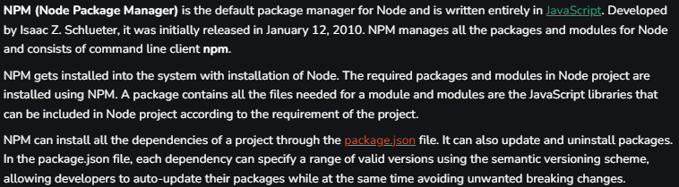
Node JS NPM

Slide 10
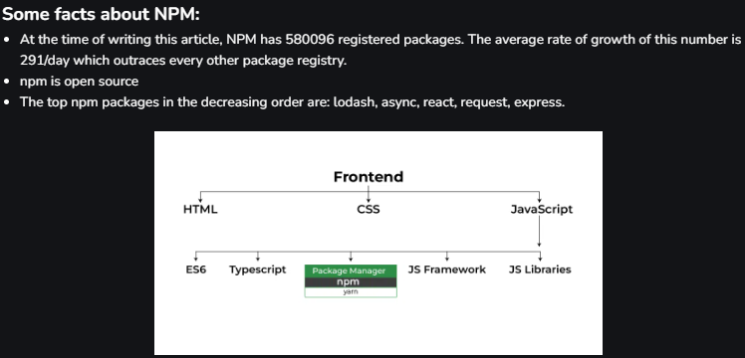
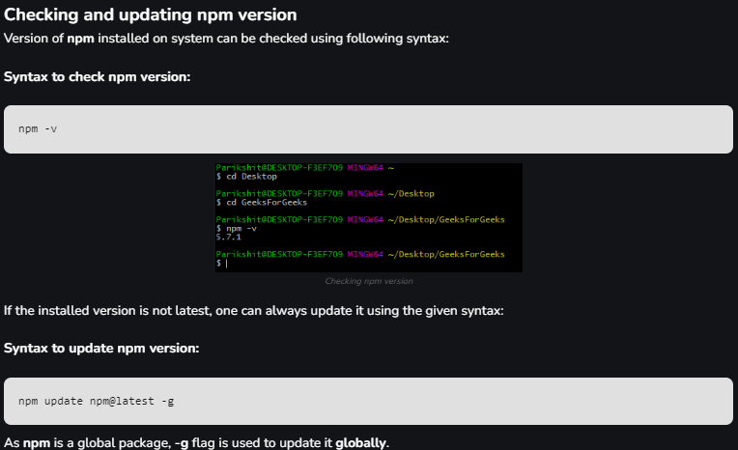
Node JS NPM
Installing NPM:
To install NPM, it is required to install Node.js as NPM gets installed with Node.js automatically.
https://nodejs.org/en/
https://www.geeksforgeeks.org/node-js-npm-node-package-manager/

Slide 11
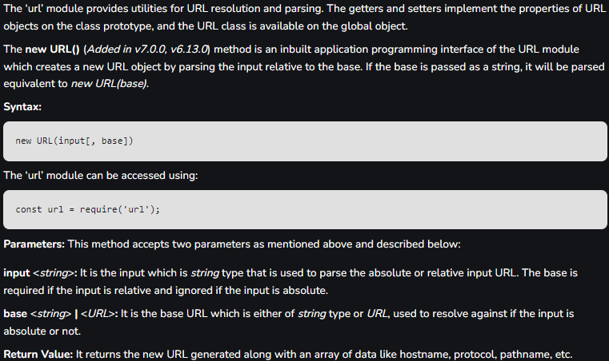
Node.js URL() Method

Slide 12
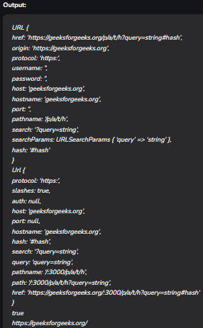
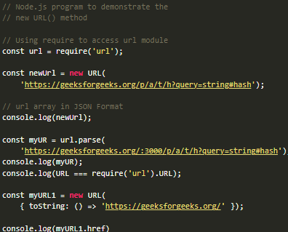

Slide 13
Node.js Connect Mysql with Node app
https://www.geeksforgeeks.org/node-js-connect-mysql-with-node-app/
Node.js is a powerful platform for building server-side applications, and MySQL is a widely used relational database.
Connecting these two can enable developers to build robust, data-driven applications.
Prerequisites:
Node.js: Download and install from nodejs.org.
MySQL: Download and install from mysql.com.
MySQL Workbench (optional): A GUI tool for MySQL, helpful for database management
Important Points
NodeJs: An open-source platform for executing javascript code on the server side. Also a javascript runtime built on Chrome’s V8 JavaScript engine.
Mysql: An open-source Relational Database Management System (RDBMS) that uses Structured Query Language (SQL). It is the most popular language for adding, accessing and managing content in a database. Here we will use the Mysql as a database for our node application.
Node -v: It will show node version in our system.
Mysql -v: It will show Mysql version in our system.

Slide 14
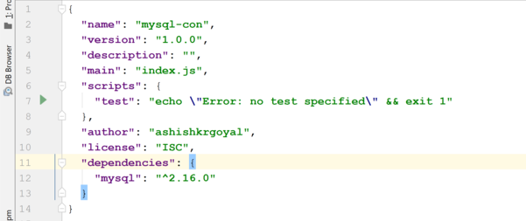
Node.js Connect Mysql with Node app
Create a New Node.js Project
Step 1: Open your terminal and create a new directory for your project.
mkdir node-mysql-app
cd node-mysql-app
Step 2: Initialize a new Node.js project:
npm init -y
Step 3: Install MySQL Package
Install the mysql package, which is a Node.js driver for MySQL:
npm install mysql
Step 4: The updated dependencies in package.json file will look like

Slide 15
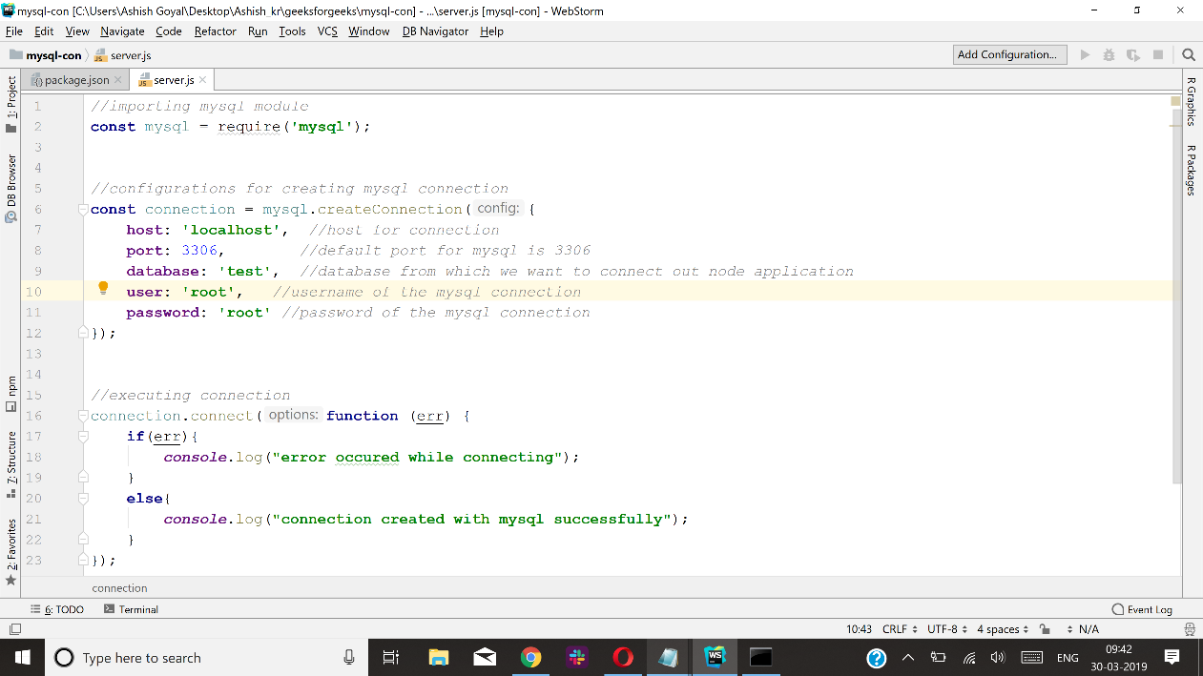
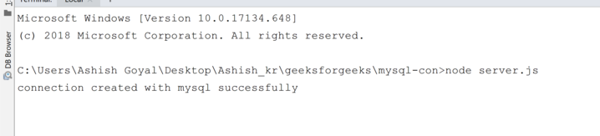
Node.js Connect Mysql with Node app
Step 5: Database Connection
Create a Javascript file named server.js in the root of the project folder. Code for creating connection is as given below:
Run the file server.js with following command as:
node server.js

Slide 16
Difference Between MongoDB and MySQL
Feature | MongoDB | MySQL
Data Model | Document-oriented (JSON-like BSON) | Relational (tables with rows and columns)
Schema | Schema-less, flexible | Schema-based, structured
Scalability | Horizontal scaling (sharding) | Vertical scaling
Transactions | Supports multi-document ACID transactions (since v4.0) | Supports ACID transactions
Query Language | MongoDB Query Language (MQL) | Structured Query Language (SQL)
Data Storage | Stores data in collections of documents | Stores data in tables
Indexing | Supports various types of indexes | Supports various types of indexes
Performance | Generally faster for read/write operations in large datasets | Generally reliable and consistent performance
Use Cases | Best for hierarchical data, real-time analytics, content management | Best for structured data, transactional applications
Join Operations | Limited support for joins, typically done in application logic | Full support for joins between tables
Replication | Replica sets for high availability and redundancy | Master-slave replication, Group Replication
Flexibility | Highly flexible, easily adapts to changing requirements | Less flexible, schema changes require careful planning
Support for Unstructured Data | Excellent, can store any type of data in a document | Limited, primarily structured data

Slide 17
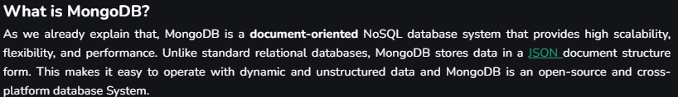
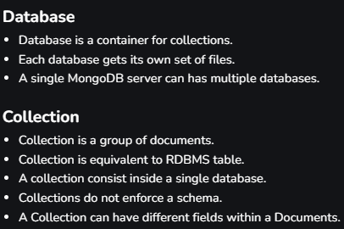
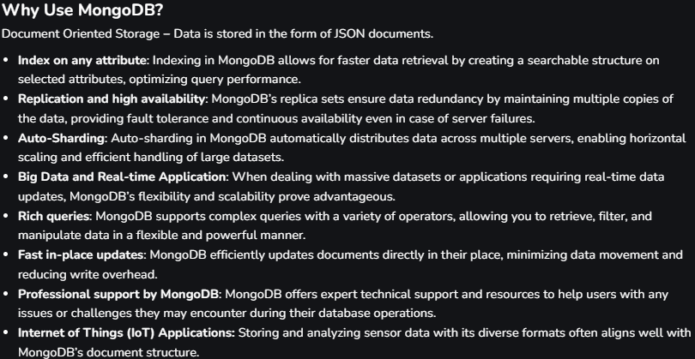
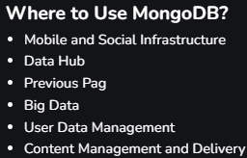
MongoDB

Slide 18
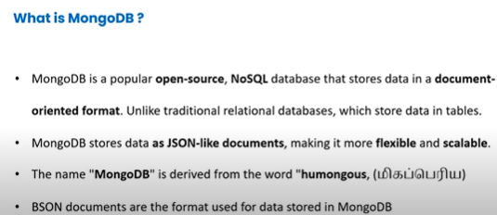
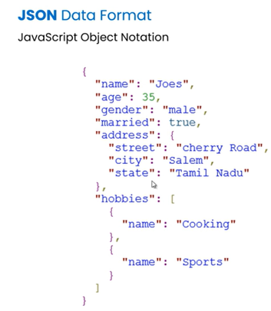
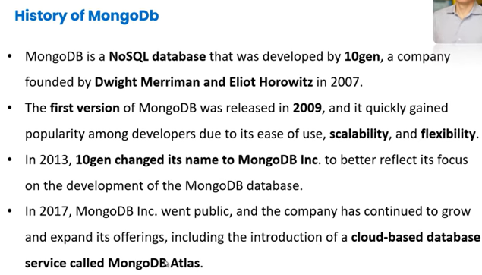
MongoDB

Slide 19
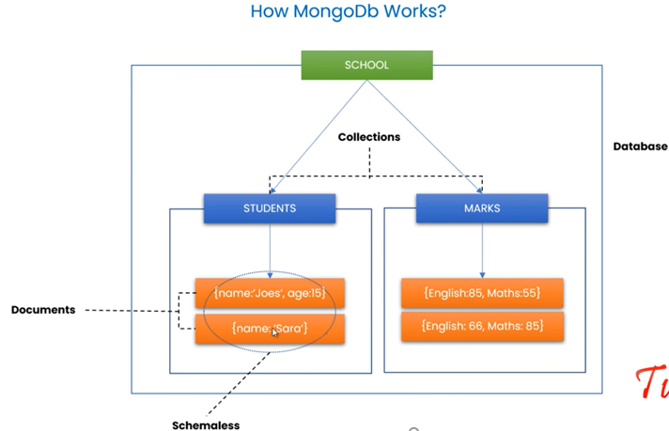
MongoDB

Slide 20
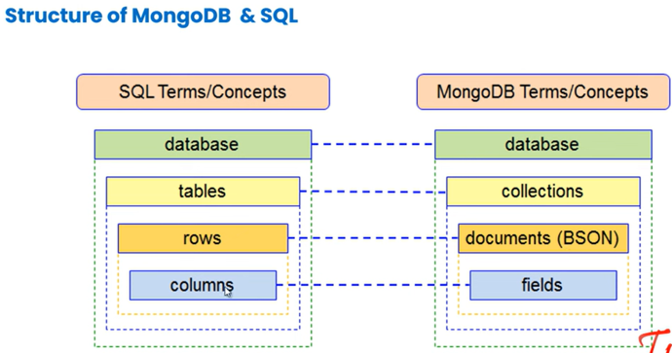
MongoDB

Slide 21
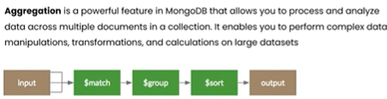
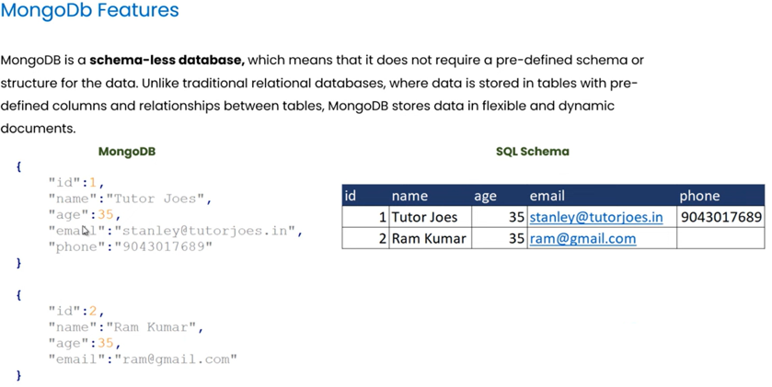
MongoDB features

Slide 22
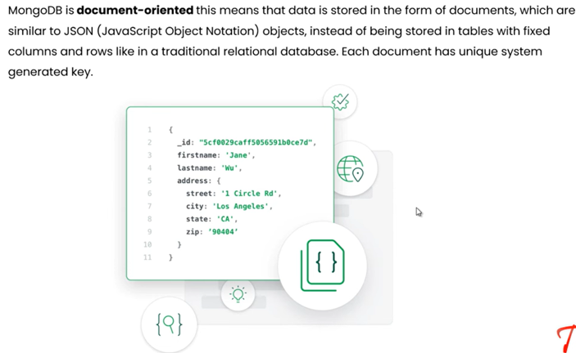
MongoDB features

Slide 23
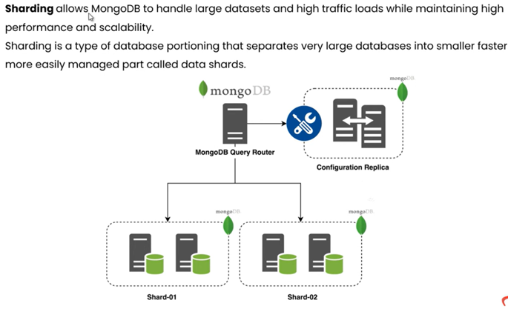
MongoDB features

Slide 24
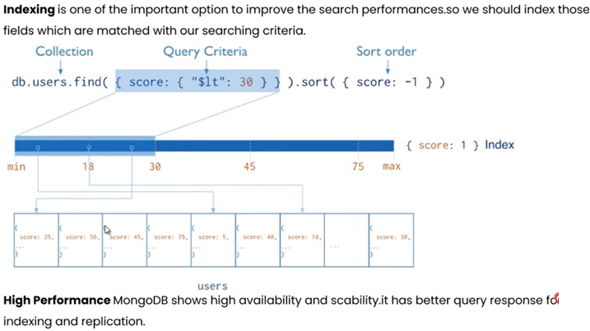
MongoDB features

Slide 25
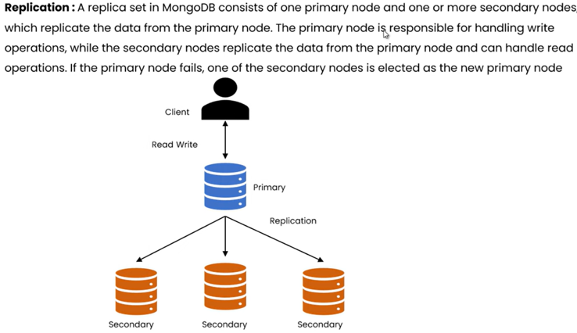
MongoDB features

Slide 26
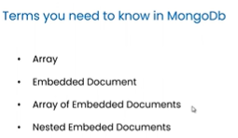
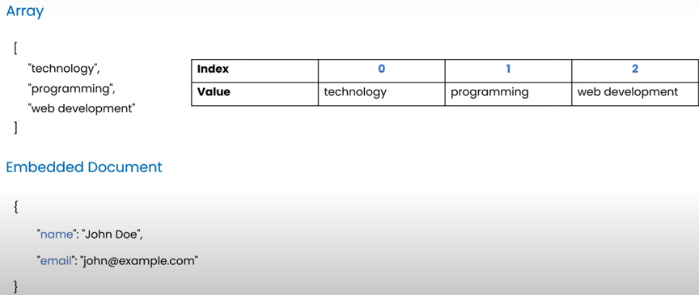
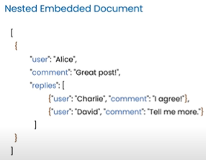
MongoDB
https://www.mongodb.com/try/download/community
https://www.mongodb.com/try/download/shell
Go to environment variables
Set path from “bin”
Cmd>>> mongosh --help

Slide 27
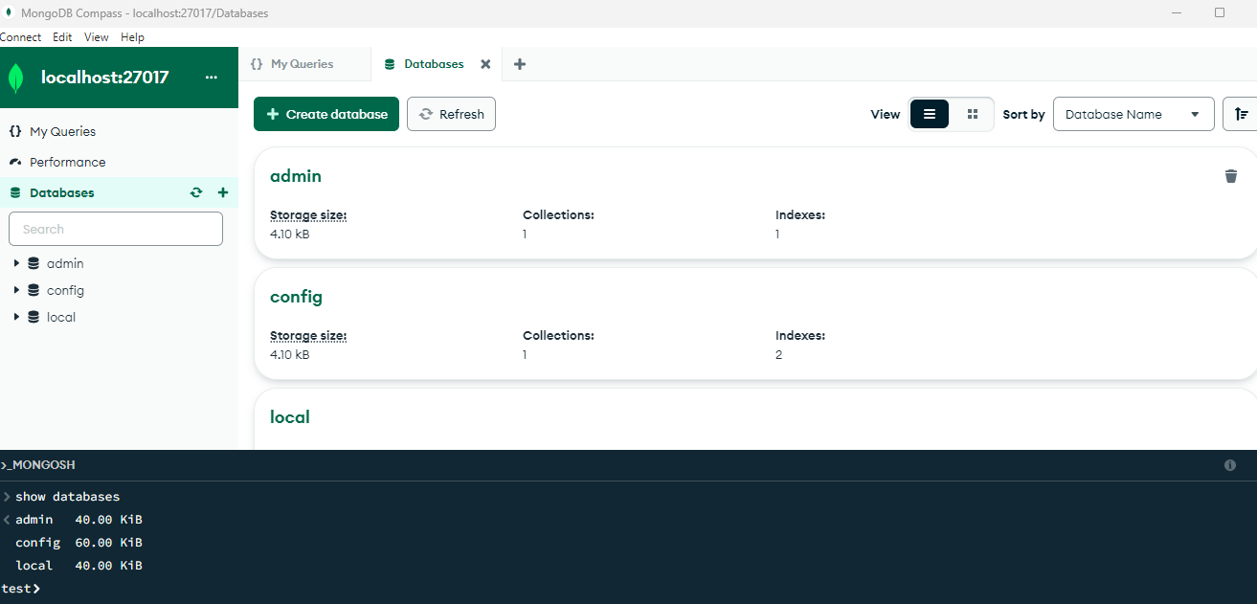
MongoDB

Slide 28
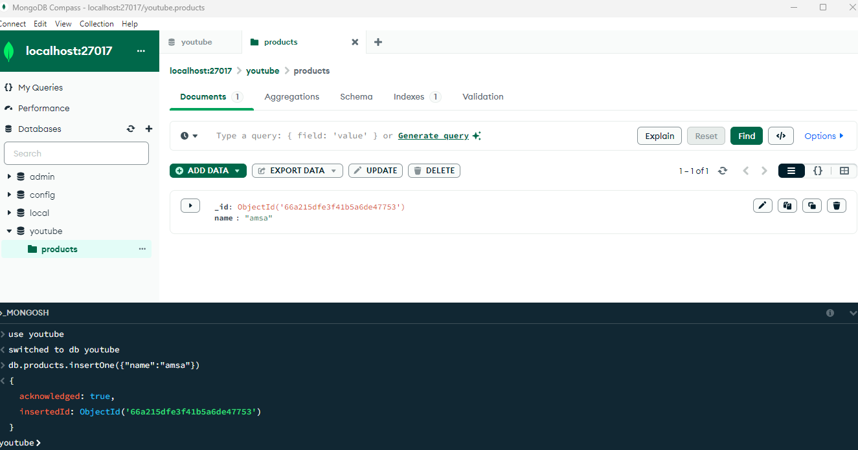
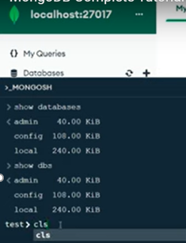
MongoDB

Slide 29
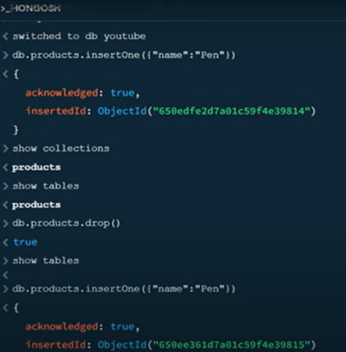
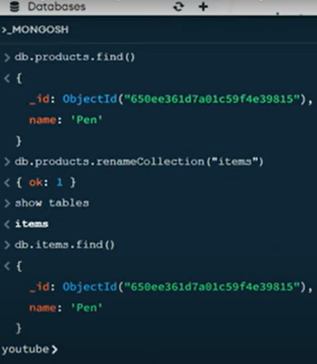
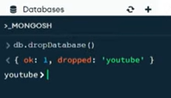
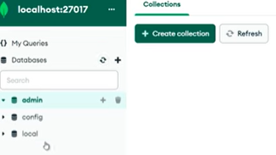
MongoDB
Now youtube db is deleted

Slide 30
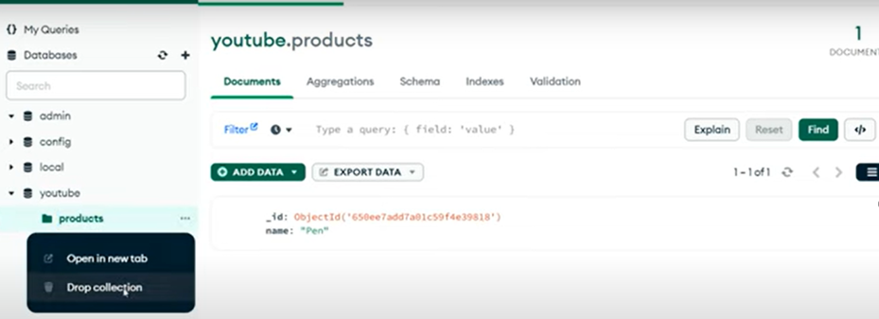
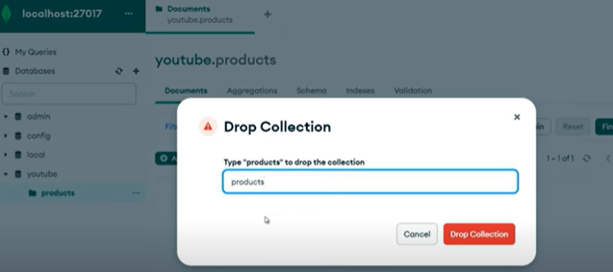
MongoDB

Slide 31
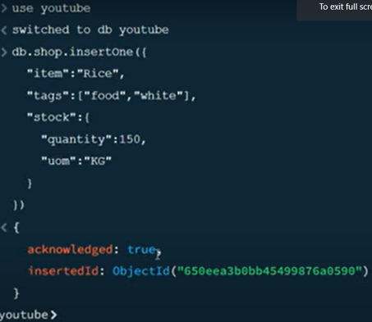
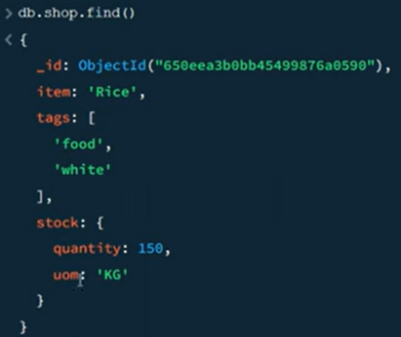
MongoDB
For multiple fields :

Slide 32
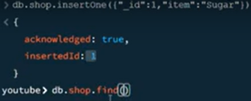
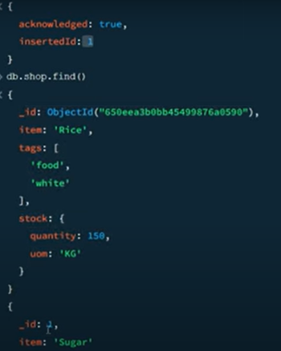
MongoDB

Slide 33


